Slide 1


Understanding Computers
15th Edition
Today and Tomorrow
Comprehensive
Chapter 3
Storage
Deborah Morley Charles S. Parker
Copyright 2015 Cengage Learning

Slide 2
Learning Objectives
Name several general characteristics of storage systems.
Describe the two most common types of hard drives and
what they are used for today.
Discuss the various types of optical discs available today and how they differ from each other.
Identify some flash memory storage devices and media and
explain how they are used today.
List at least three other types of storage systems.
Summarize the storage alternatives for a typical personal
computer.

Slide 3
Overview
This chapter covers:
  The characteristics common among all storage systems
  The primary storage for most personal computers—the
hard drive
  How optical discs work and the various types that are
available today
  Flash memory storage systems
  Network and cloud storage, smart cards, holographic storage, and storage systems used with large computer systems
  Storage alternatives for a typical personal computer

Slide 4
Storage System Characteristics
Storage Media and Storage Devices
  Medium
    Hardware where data is stored
    DVD disc, flash memory card, etc.
  Device
    DVD drive, flash memory card reader, etc.
    Medium is inserted into device to be used
  Can be internal, external, or remote
  Storage devices are typically identified by letter

Slide 5
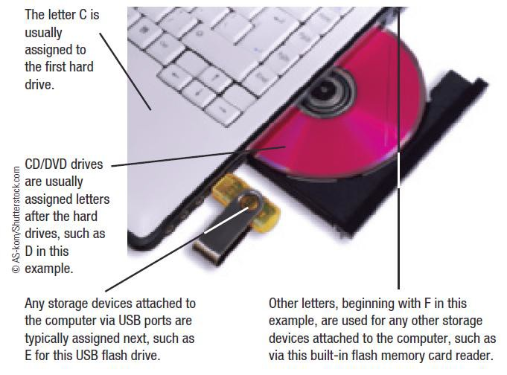
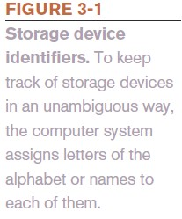
Storage System Characteristics

Slide 6
Storage System Characteristics
Volatility
  Storage media are nonvolatile
Random vs. Sequential Access
  Random access (direct access) allows data to be retrieved from any location on the storage medium
  Virtually all storage devices use random access
  Sequential access means retrieval of data can occur only in the order in which it was physically stored on the storage medium
    Magnetic tape drive

Slide 7
Storage System Characteristics
Logical vs. Physical Representation
  File
    Anything stored on a storage medium, such as a
program, document, digital image, or song
  Filename
    Name given to a file by the user
  Folder
    Named place on a storage medium
into which files can be stored

Slide 8
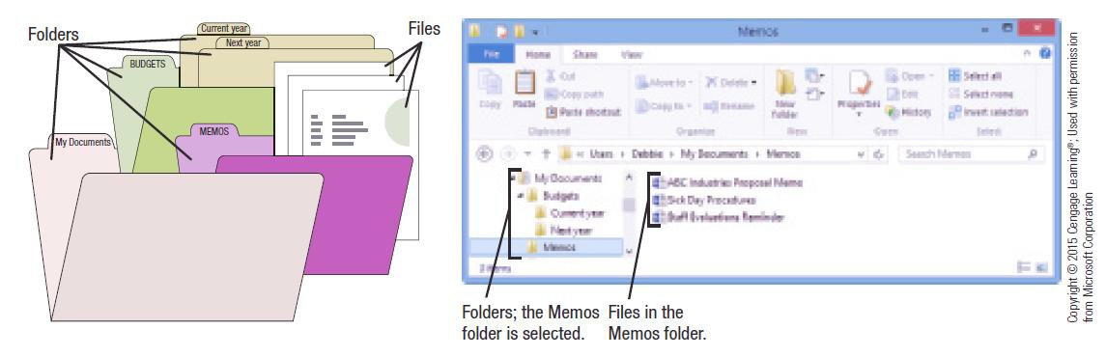
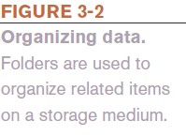
Storage System Characteristics

Slide 9
Storage System Characteristics
Logical file representation
  Individuals view a document stored as one complete
unit in a particular folder on a particular drive
Physical file representation
  Computers access a particular document stored on a
storage medium using its physical location or locations
Types of Storage Technology Used
  Magnetic (conventional hard drives)
  Optical (optical discs)
  Electrons (flash memory media)

Slide 10
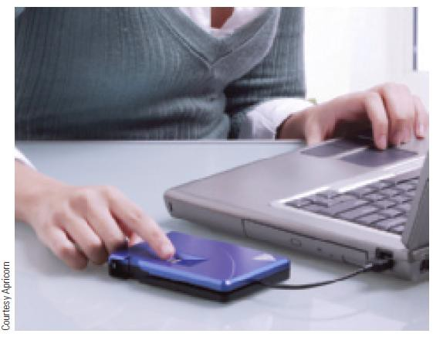
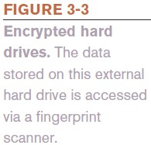
Hard Drives
Hard Drive
  Used to store most
programs and data
  Can be internal or external
  Can be encrypted
Magnetic Hard Drives
  One or more permanently sealed metal magnetic disks with an access mechanism and read/write heads
10

Slide 11
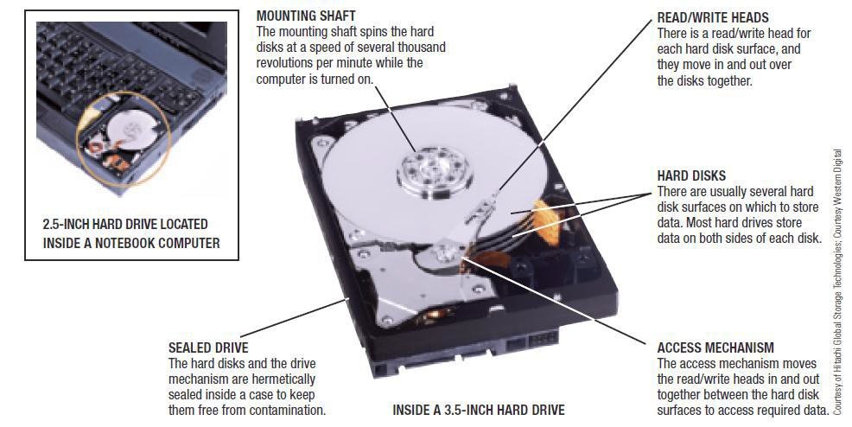

Hard Drives

Slide 12
Hard Drives
Hard disks are divided into:
  Tracks
    Concentric path on disk where data is recorded
  Sectors
    A small piece of the track
  Clusters
    One or more sectors; smallest addressable area of a disk
  Cylinders
    Collection of tracks located in the same location on a set of hard disk surfaces

Slide 13
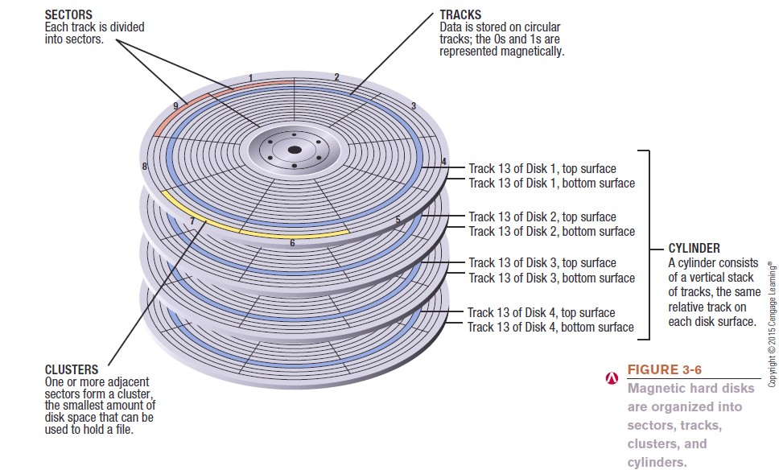
Hard Drives

Slide 14
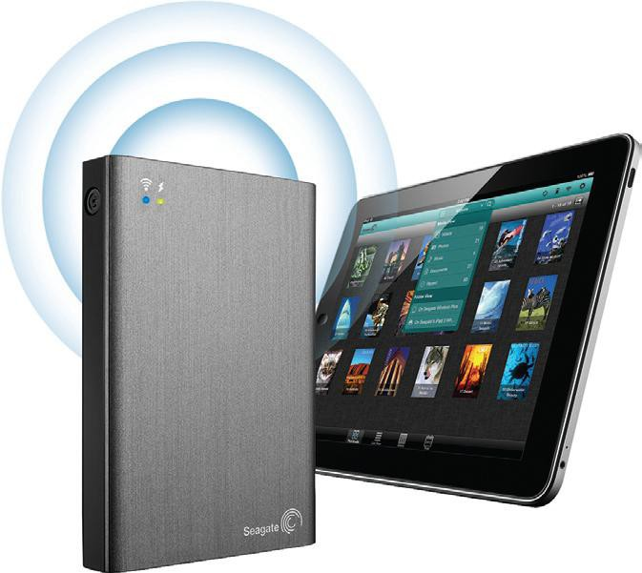
How It Works Box
More Storage for Your Tablet
Media tablets often have
64 GB of storage
To extend storage, can transfer content to and from PCs
Easier is to use a wireless hard drive
Need the appropriate app

Slide 15
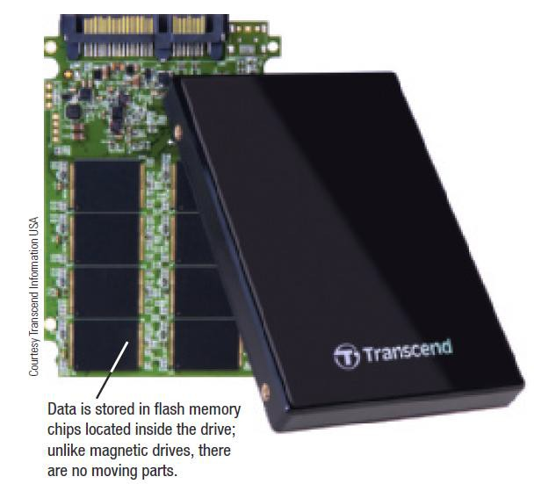

Hard Drives
Solid State Drives (SSDs)
  Use flash memory
technology
  Use less power and have no moving parts
  Particularly appropriate for portable computers and mobile devices

Slide 16
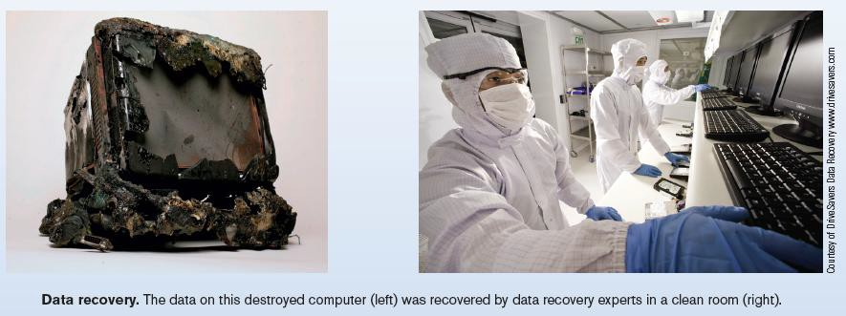
Inside the Industry Box
Data Recovery Experts
Can recover data from damaged storage devices
Can be used when devices are physically damaged or
just stop working
Back up to prevent data loss

Slide 17
Internal and External Hard Drives
Internal hard drives
  Permanent storage devices located inside the system unit
  Removed only if a problem develops
External hard drives
  Commonly used to transport large amounts of data from
one computer to another
  Portable external hard drives are smaller and easier to transport
  Most connect with a USB connection although some may
be wireless

Slide 18
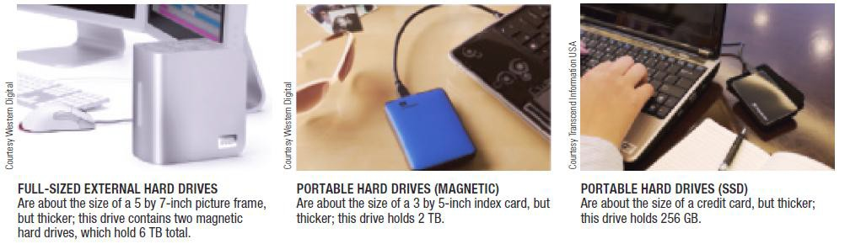

Internal and External Hard Drives

Slide 19
Hard Drive Speed, Disk Caching, and Hybrid Hard Drives
Disk access time
  Total time that it takes for a hard drive to read or write
data
  Consists of seek time, rotational delay, and data movement time
    SSDs don’t require seek time or rotational delays
Disk cache
  Memory used in conjunction with a magnetic hard drive to
improve system performance
  Typically consist of memory chips on a circuit board inside the hard drive case

Slide 20
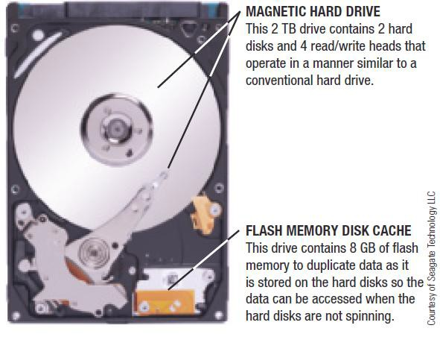
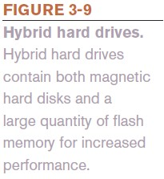
Hard Drive Speed, Disk Caching, and Hybrid Hard Drives
Hybrid Hard Drive
  Combination of flash memory and magnetic hard drive
  Uses flash memory for
cache
  Allows encryption to be built into the drive
20

Slide 21
Hard Drive Partitioning and File Systems
Partitioning
  Divides the physical capacity of a single drive logically into
separate areas, called partitions
  Partitions function as independent hard drives
  Referred to as logical drives
  Increases efficiency (smaller drives use smaller clusters)
Partitions used to create:
  A recovery partition
  A new logical drive for data
  A dual boot system

Slide 22
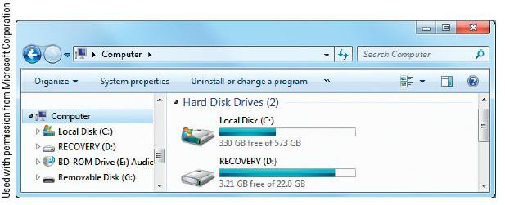
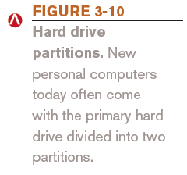
Hard Drive Partitioning and File Systems
File system
  Determines the partition size, cluster size, maximum drive
size, and maximum file size
    FAT, FAT32, and NTFS

Slide 23
Hard Drive Interface Standards
Determine how a drive connects to the computer
Common standards
  Parallel ATA (PATA) - older, slower standard
  Serial ATA (SATA)
  eSATA
  SCSI and the newer serial attached SCSI (SAS)
  Fibre Channel
  Fibre Channel over Ethernet (FCoE)
  Internet SCSI (iSCSI)

Slide 24
Quick Quiz
Of the following three options, the storage media that would likely hold the most data is a(n) .
  internal hard drive
  USB flash memory drive
  portable hard drive
True or False: Hard drives typically contain more than one metal
hard disk.
The circular rings on a magnetic disk on which data is stored are called .
Answers:
1) a; 2) True; 3) tracks

Slide 25
Optical Discs and Drives
Optical Disc Characteristics
  A type of storage read from and written to using laser
beams
  Today’s standard for software delivery
  Divided into sectors like magnetic discs but use a single
spiral track (groove)
  Have a relatively large capacity and are durable
  Used for backup purposes and for storing and transporting
music, photos, video, etc.

Slide 26
Optical Discs and Drives
Representing Data on an Optical Disc
  Read-only optical disc
    Surface of disc is molded or stamped
  Recordable or rewritable disc
    Optical drive is used and the reflectivity of the disc is
changed using a laser to represent the data
  Pits and lands are used to represent 1s and 0s
  The transition between a pit and a land represents a 1; no
transition represents a 0

Slide 27
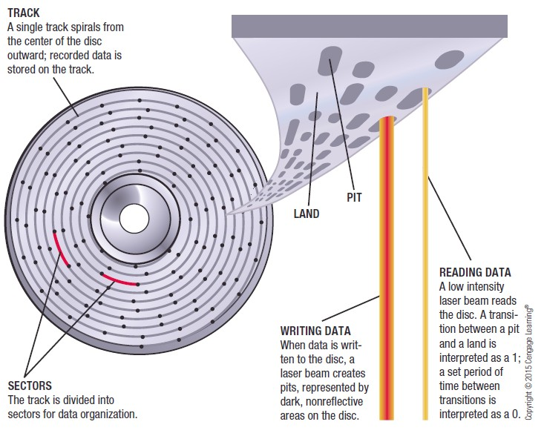

Optical Discs and Drives

Slide 28
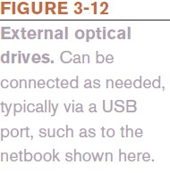
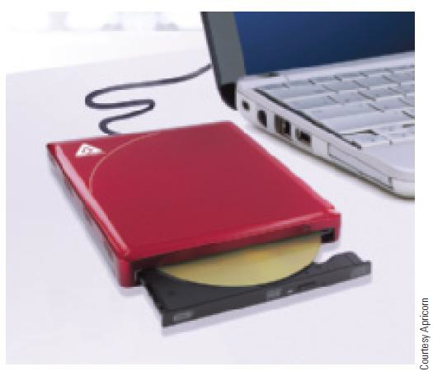
Optical Discs and Drives
Optical Drives
  Three categories of discs: CD, DVD, or Blu-Ray Disc (BD)
  Can be read-only, recordable, or rewritable
  Almost always downward compatible
  Can support single or dual layer discs
  Recording data onto disc is called burning
  Can be internal or external drives
    External drives typically connect via USB port

Slide 29
Optical Discs and Drives
Optical Disc Shapes, Sizes, and Capacities
  Standard size is 120-mm (about 4.7 inches)
    Mini discs are smaller—80-mm
  Theoretically can be made into various shapes—hearts, triangles, irregular shapes, or a hockey-rink shape
    Patent battle exists about changing optical disc shapes
    None of these different shapes are currently available

Slide 30

Optical Discs and Drives
Major advantage: large capacity
  CD discs are normally single layer and hold 650 or 700 MB
  DVD discs hold 4.7 GB (single-layer) or 8.5 GB (dual-layer
  BD discs hold 25 GB (single-layer) or 50 GB (dual-layer
  Discs can also be double-sided
  Researchers continually work to
increase the capacity of optical discs
    DL and XL discs
    4K (Ultra HD) Blu-ray Discs
30

Slide 31
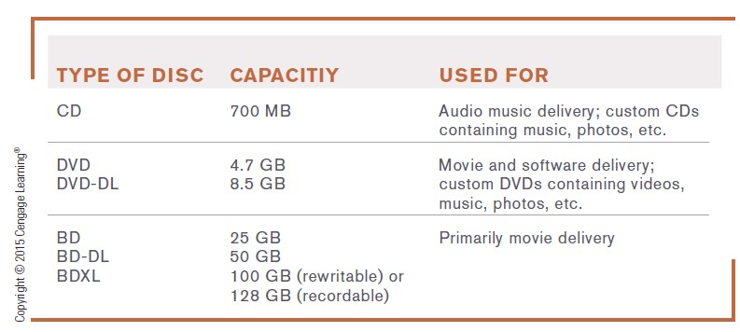

Optical Discs and Drives

Slide 32
Read-Only Optical Discs
CD ROM, DVD ROM, and BD-ROM
  Can be read from, but not written to, by the user
    CD-ROM (compact disc read-only memory)
    DVD-ROM (digital versatile disc read-only memory)
    BD-ROM (Blu-Ray Disc read-only memory)
  Normally come pre-recorded
    Software programs
    Clip art and other graphics
    Music
    Movies
    Games (PlayStation, Wii, Xbox, etc.)

Slide 33
Recordable Optical Discs
CD-R, DVD-R, DVD+R, BD-R Discs
  Can be written to, but cannot be erased and reused
  No physically molded pits
  Most have a recording layer containing organic light- sensitive dye between disc’s plastic and reflective layers
    Except the BD-R disc, which has inorganic material
  Used for backing up files, sending large files to others, and creating custom music CDs

Slide 34
Rewritable Optical Discs
CD-RW, DVD-RW, DVD+RW, and BD-RE Discs
  Can be written to, but cannot be erased and reused
    Uses phase change technology
– Heating and cooling process is used to change the reflectivity of the disc
    Capacities are identical to the read-only and recordable
discs, except BDXL
  Appropriate for transferring large files from one computer
to another or temporarily storing TV shows

Slide 35
Quick Quiz
The capacity of the typical CD disc is .
  50 GB
  700 MB
  4.7 GB
True of False: A DVD-RW disc can be written to and rewritten to.
The tiny depressions, dark areas, or otherwise altered spots on an
optical disc that are used to represent data are called .
Answers:
1) b; 2) True; 3) pits

Slide 36

Trend Box
DNA Data Storage
Possible data storage medium
  Long-term, high-density encoding
Researchers have encoded data in DNA
  Translated into binary 0s and 1s, then to a ternary code, and then as strings of DNA’s chemical bases and stored in DNA
Biggest obstacle is cost - $12,400/MB
Biggest possibility: archiving

Slide 37
Flash Memory Storage Systems
Flash Memory
  Chip-based storage medium that represents data using
electrons
  Used in SSDs and hybrid hard drives
Embedded Flash Memory
  Flash memory chips embedded into products, such as
    Portable digital media players, digital cameras
    Handheld gaming devices, GPS devices, mobile phones
    Sunglasses and wristwatches

Slide 38
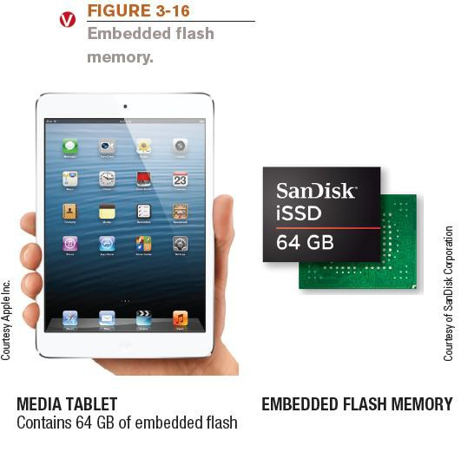
Flash Memory Storage Systems

Slide 39
Flash Memory Storage Systems
Flash Memory Cards and Readers
  Flash memory card
    Small card containing one or more flash memory chips, a controller chip, and metal contacts to connect the card to the device or reader with which it is being used
    Available in various formats that are not
interchangeable:
CompactFlash | Secure Digital (SD) | xD Picture Card
Memory Stick | Secure Digital High Capacity (SDHC)
MultiMedia Card (MMC) | Secure Digital Extended Capacity (SDXC)

Slide 40
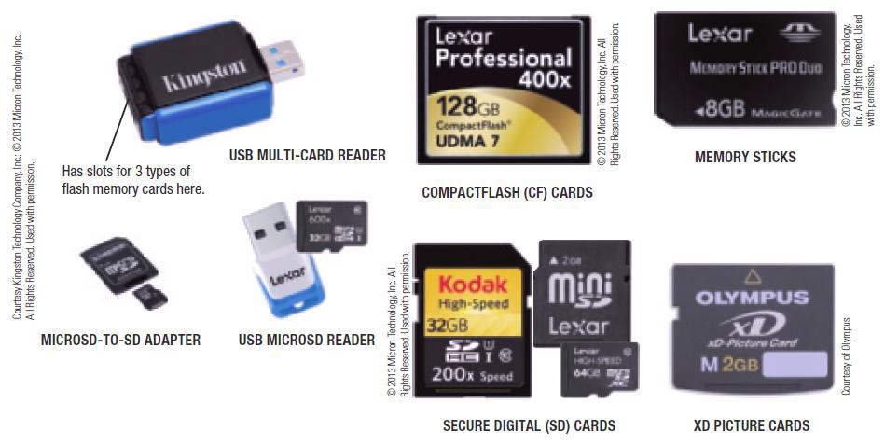
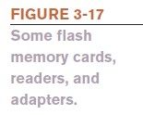
Flash Memory Storage Systems
40

Slide 41
Flash Memory Storage Systems
General-purpose flash memory card
  Appropriate for most applications
Specialized flash memory cards
  Professional flash memory cards
    Designed for professional photographers
  Gaming flash memory cards
    Designed for gaming consoles
  HD flash memory cards
    Designed for capturing and transferring high-definition video

Slide 42
Flash Memory Storage Systems
USB Flash Drives
  Sometimes called flash memory drives, jump drives, or
thumb drives
  Flash memory media integrated into a self-contained unit that plug into and is powered by a USB port
  Designed to be very small and very portable
  Available in a host of formats including custom shapes
  Can be built into a consumer product
  Can be used to lock a computer and to issue Web site passwords
  Can include biometric features, such as a built-in fingerprint reader

Slide 43
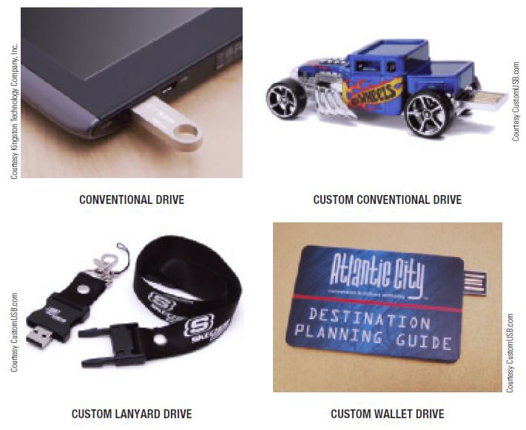

Flash Drive Storage Systems

Slide 44
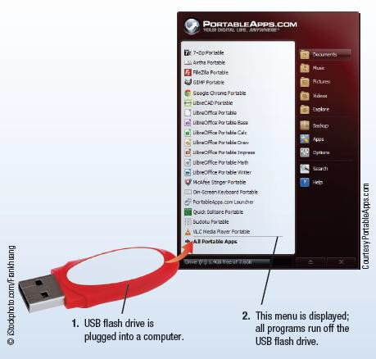
Technology and You Box
Thumb Drive PCs
Portable apps turn USB flash drives and other small devices into personal computers
Download app and desired software to the USB flash drive
To use, plug into a computer

Slide 45
Other Types of Storage Systems
Network Storage and Cloud Storage Systems
  Remote storage
    Using a storage device not directly connected to the
computer being used
    Accessed through the Internet or through a network
  Network storage
    Remote storage via local network

Slide 46
Network and Cloud Storage Systems
Network attached storage (NAS)
  High performance storage systems connected individually
to a network
  Designed for small business and home use
Storage area network (SAN)
  Separate network of hard drives or other storage devices
which are attached to the main network

Slide 47
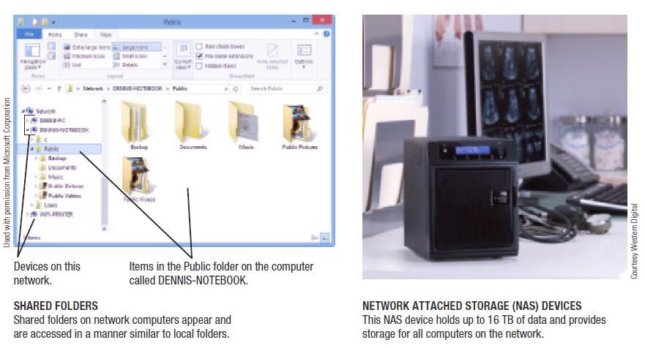

Network and Cloud Storage Systems

Slide 48
Network and Cloud Storage Systems
Cloud storage (online storage)
  Accessed via the Internet
    Via Web sites (Flickr, Facebook, Google Docs, etc.)
    Via online storage sites (Box, Dropbox, etc.)
    Growing in importance because more and more
applications are Web based
    Increasing being used for backup purposes
    Files can be synched between PC and cloud storage
    Many Web sites providing online storage offer it free
    Business cloud storage is available

Slide 49
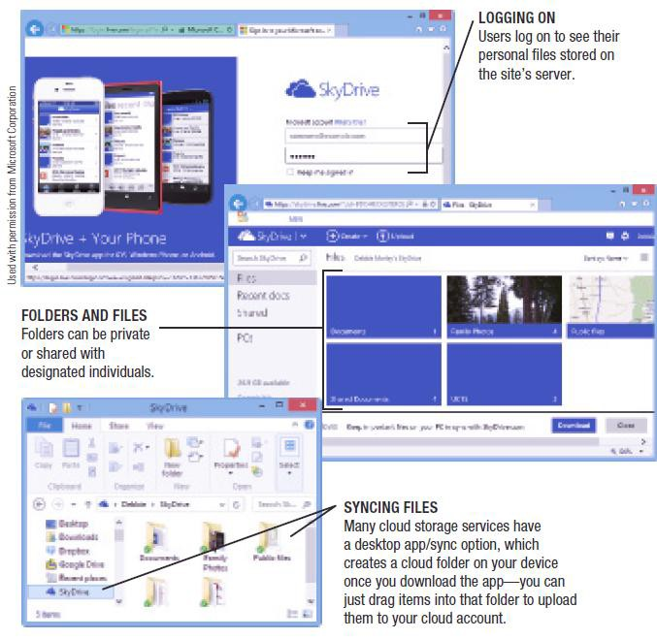
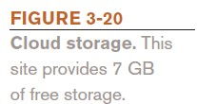
Network and Cloud Storage Systems

Slide 50
Smart Cards
Smart Card
  Credit card-sized piece of plastic that contains some
computer circuitry (processor, memory, and storage)
  Stores small amount of data (about 64 KB or less)
  Commonly used to store prepaid amounts of digital cash or
personal information
  Smart card readers are built into or attached to a computer, door lock, vending machine, or other device
  Some smart cards store biometric data
  Use of mobile smart cards is an emerging trend
50

Slide 51
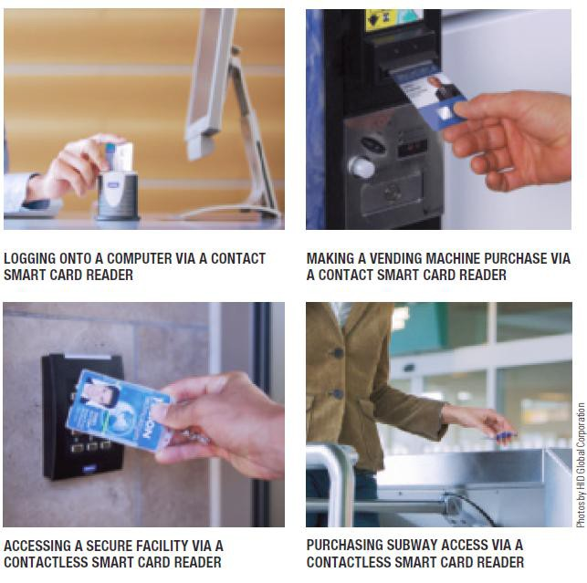

Smart Cards

Slide 52
Holographic Storage
Holographic storage
  Holographic drives connect to a computer via a serial
attached SCSI (SAS) or Fibre Channel interface
  Uses multiple blue laser beams to store data in three dimensions
    Reference beam and signal beam
  Suited to applications in which large amounts of data need to be stored or retrieved quickly but rarely changed
    Archiving business data, medical records, TV shows,
sensor data , etc.

Slide 53
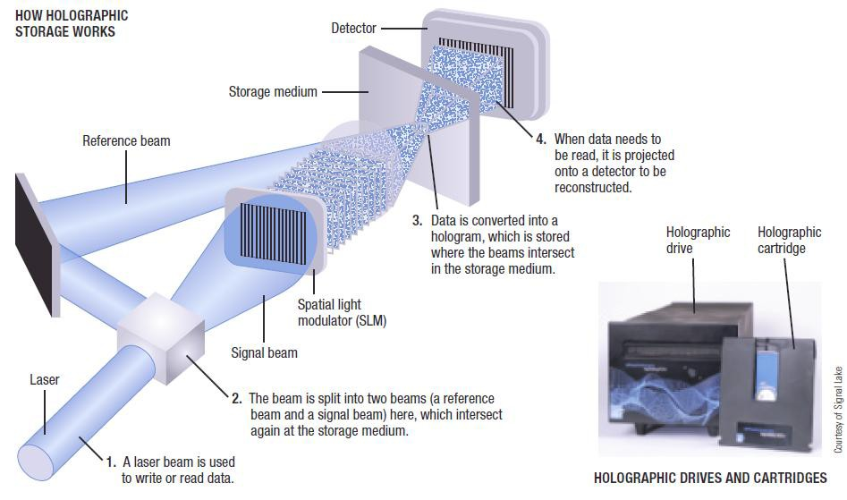
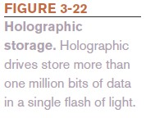
Holographic Storage

Slide 54
Storage Systems for Large Computer Systems
Business storage needs are growing exponentially
  Digital data produced is expected to double every two
years through 2020
Storage server
  Hardware device containing multiple high-speed hard
drives connected to the computer system or network
  Most are based on magnetic hard discs

Slide 55
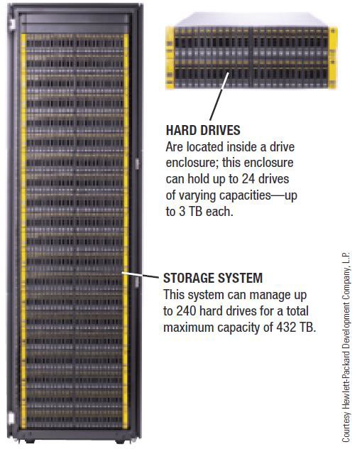
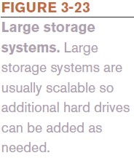
Storage Systems for Large Computer Systems

Slide 56
Storage Systems for Large Computer Systems
RAID (redundant arrays of independent discs)
  Method of storing data on two or more hard drives that
work together to do the job of a larger drive
  Mostly used to protect critical data on large storage systems
  Usually involves recording redundant copies of stored data
  Helps to increase fault tolerance

Slide 57
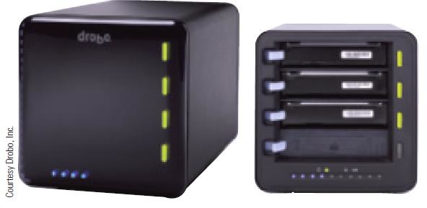

Storage Systems for Large Computer Systems
Different levels of RAID:
  RAID 0 = disk striping (spread files over two or more hard drives)
  RAID 1 = disk mirroring (duplicate copy)
  Other level use a combination or striping and mirroring
Drobo system
  New RAID storage system
  Much easier to use than previous
systems
  Offers continuous data redundancy
RAID is not a backup: RAID protects against hardware and drive failure, not against file deletion, ransomware, corruption, or catastrophic physical damage.

Slide 58
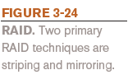
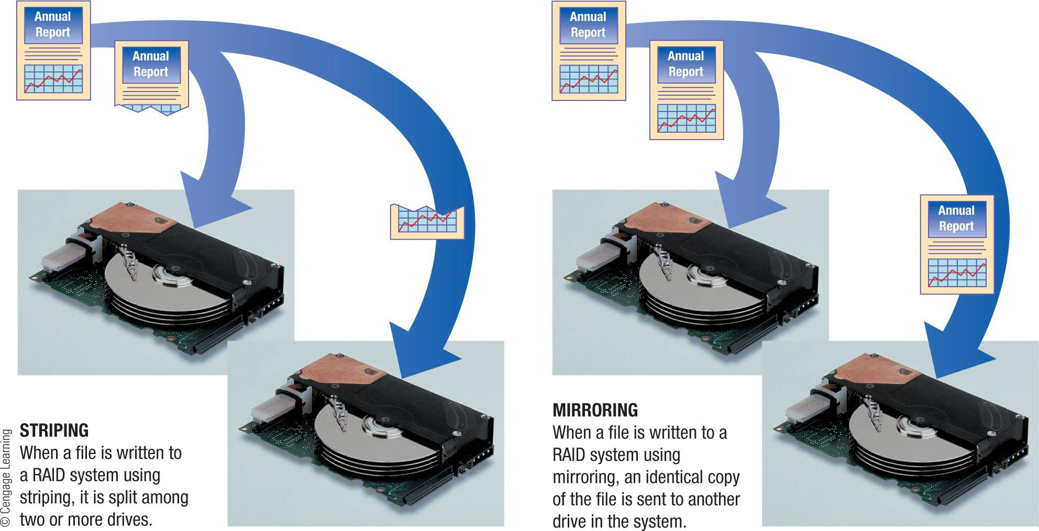
Storage Systems for Large Computer Systems

Slide 59
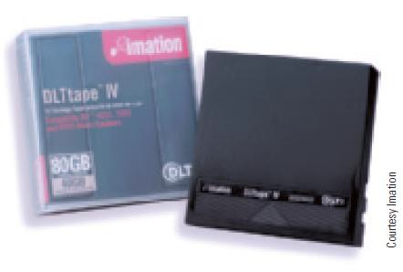
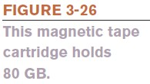
Magnetic Tape Systems
Magnetic Tape
  Plastic tape coated with a magnetizable substance that
represents the bits and bytes of digital data
  Primarily used for backup and archival purposes
  Sequential access only
  Low cost per terabyte
  Most tapes today are in the form of cartridge tapes

Slide 60
Evaluating Your Storage Alternatives
Product Characteristics to Consider:
  Speed
  Compatibility
  Storage capacity
  Convenience
  Portability
Most Users Require:
  Hard drive
  Recordable or rewritable optical drive
  Flash memory card reader
  USB ports
60

Slide 61
Quick Quiz
An online photo sharing site is an example of .
  RAID
  cloud storage
  holographic storage
True or False: Flash memory storage systems are called solid-
state storage systems because they are nonvolatile.
A type of sequential storage that sometimes used today for backup purposes is .
Answers:
1) b; 2) False; 3) magnetic tape
61

